Slide 1
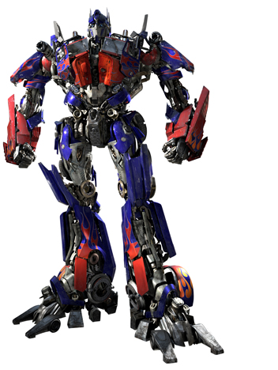
Transformer
(Jason Liao 廖振閔)
Notes:
Ok. In today’s presentation, I will introduce a famous model architecture in deep learning, Transformer.
I think everyone knows it before, so I more focus on some details that you will face when you are coding.
#By the way, the icon “transformer” comes from this one. We call it 變形金剛 in Chinese.
#If you search “transformer” on Google, you may find this one.

Slide 2
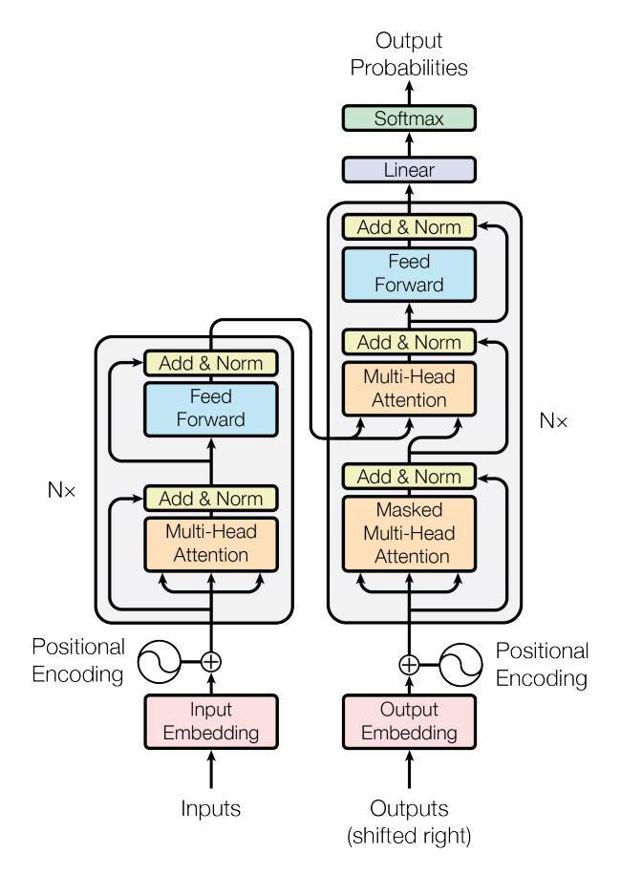
Transformer

Slide 3
Outline
Background
Attention
Positional Encoding
Multi-Head Attention
Masked Attention
Layer Normalization
QA
Homework
Notes:
This is today’s outline.
Everyone knows that the most important thing in Transformer is the self-attention layer.
So, I will explain why we need self-attention in the Background chapter.
And explain how it works in the Attention chapter.
After that, it’s some detail that Transformer used, like Positional Encoding, Multi-Head Attention, Masked Attention, and Layer Normalization.
Finally, it’s QA time and homework.
In homework, you will implement NER Using Transformer Encoder.
Ok, Let dive in.

Slide 4
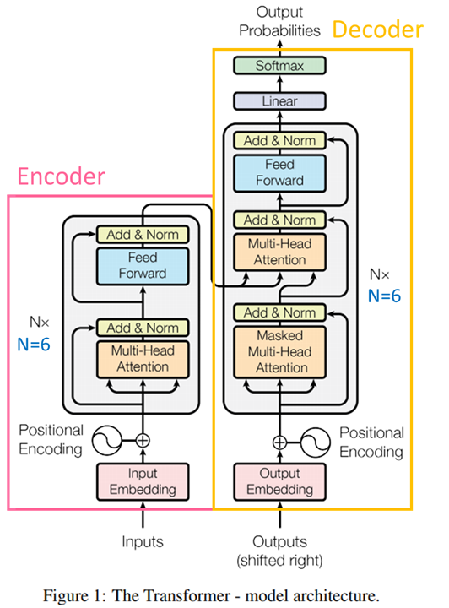
Transformer
Notes:
Here is the model architecture of the Transformer.
The transformer consists of encoder and decoder.
The encoder encodes the sentence to the latent variable, and the decoder decodes it word by word.
We can see there are lots of blocks in encoder and decoder.
Let’s start with the most important part, attention.

Slide 5
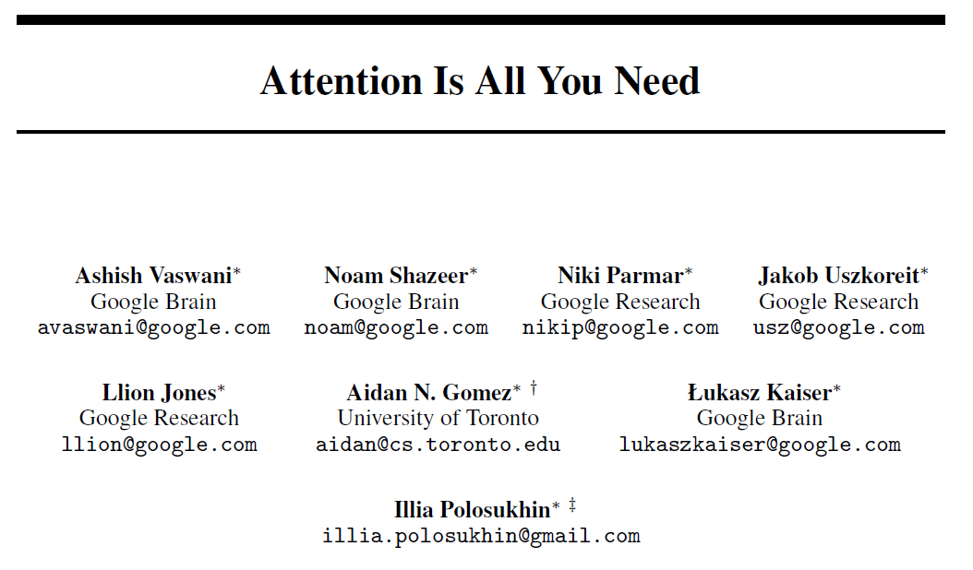
Notes:
The transformer is released by the paper, Attention is all you need.
The authors are from Google and toronto university.

Slide 6
Background
(Why do we need Self-Attention?)
Notes:
I think everyone has seen the paper before.
So, the question I want to ask is why do we need Self-Attention?

Slide 7












Sequence
Transformer – 李宏毅老師
https://www.youtube.com/watch?v=ugWDIIOHtPA
Next layer
Previous layer
Using CNN to replace RNN
Hard to parallelize
Notes:
transformer出來以前：使用RNN架構，需要依序計算每一個hidden state，難以做到平行化運算
Before transformer, we use RNN to encode or decode the sentence.
But RNN is hard to parallelize. For example, if we want to know the b2, we need to calculate the memory status 1 from a1.
And then calculate the memory status 2 from a2 and memory status 1.
To solve this problem, some research uses CNN to encode the sentence, but they result in another problem.

Slide 8




Sequence
Transformer – 李宏毅老師
https://www.youtube.com/watch?v=ugWDIIOHtPA
Filters in higher layer can consider longer sequence
Next layer
……
……
……
……
Previous layer
Using CNN to replace RNN
Hard to parallelize
(CNN can parallel)
Notes:
改善：使用CNN，雖然可以做到平行化，但有局部性的問題（解決方法就是再疊幾層Filter在前一層Filter的 output 上
CNN lookup range will restricted by the range of filter and layers number.
For example, b2 can only look at a1 to a3, because the range of filter is three.
If you need b2 to consider more words, you need more layer behind b2.

Slide 9
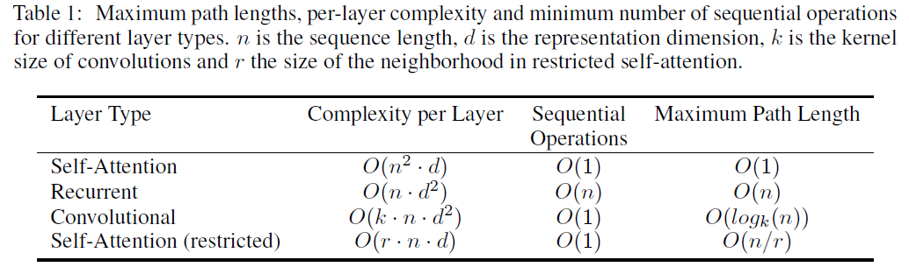
Why Self-Attention
the total computational complexity per layer
the amount of computation that can be parallelized

Slide 10
Attention
(Self Attention, Scaled Dot-Product Attention)
Notes:
To deal with this problem, the transformer uses the skill called Scaled Dot-Product Attention.

Slide 11
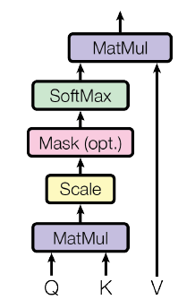

Scaled Dot-Product Attention
Notes:
Here is the formula for Scaled Dot-Product Attention.
But the formula didn’t talk about where Q, K, V come from.

Slide 12
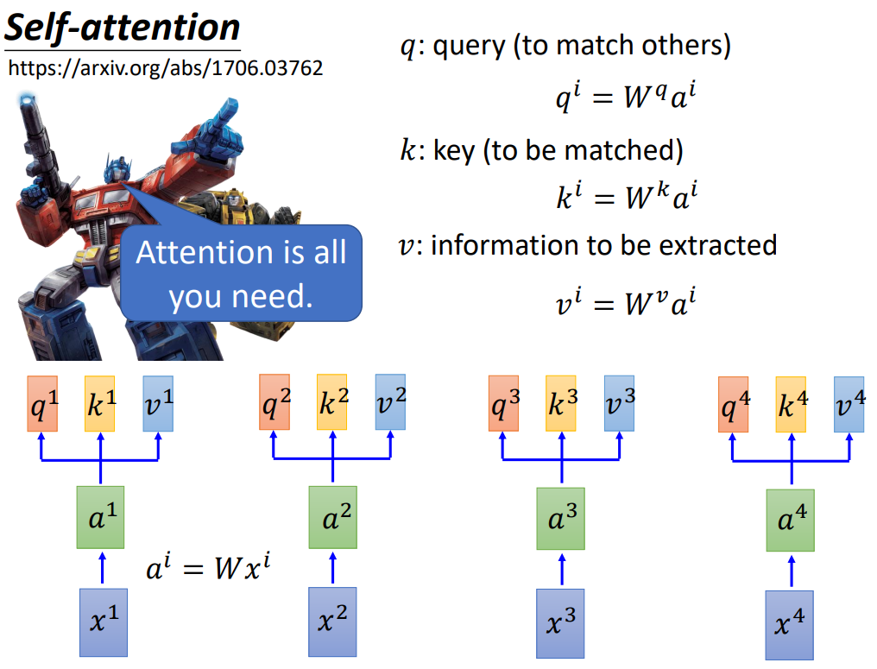

Slide 13
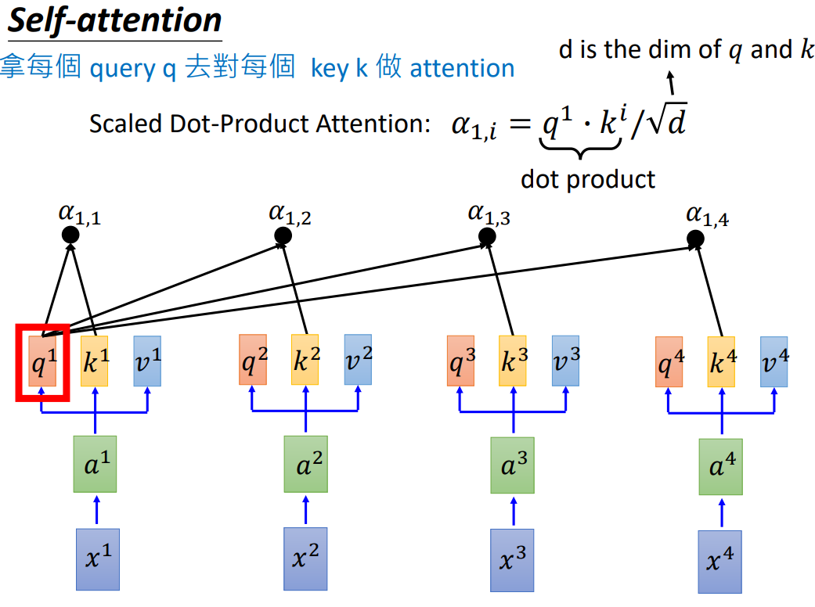

Slide 14
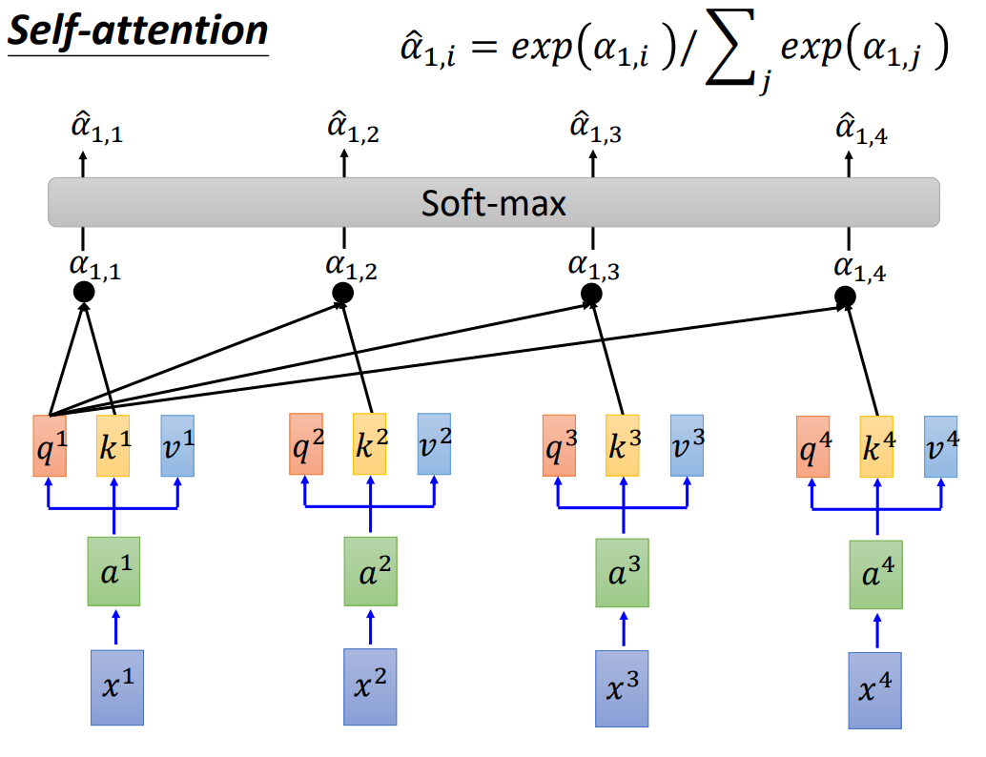

Slide 15
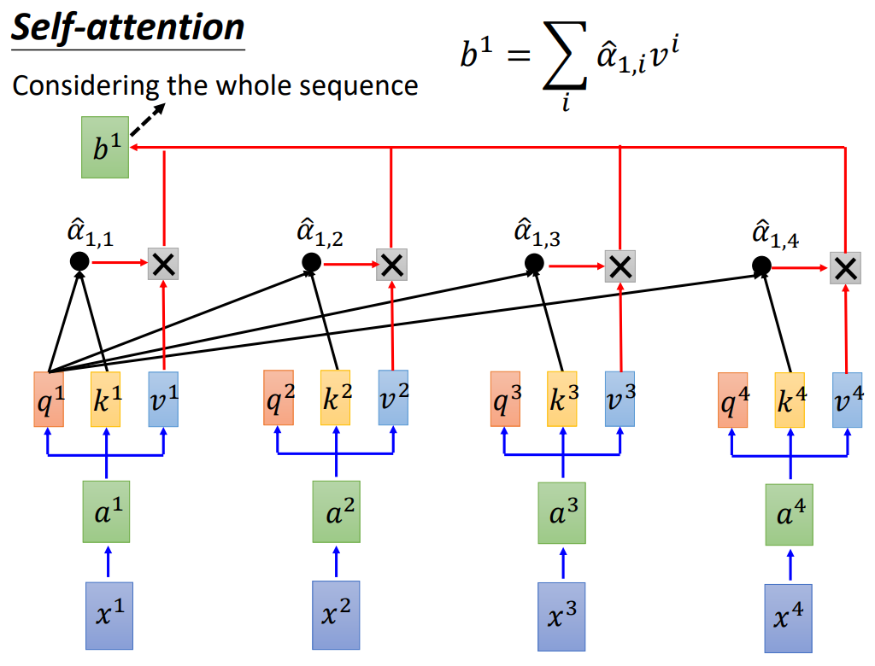

Slide 16
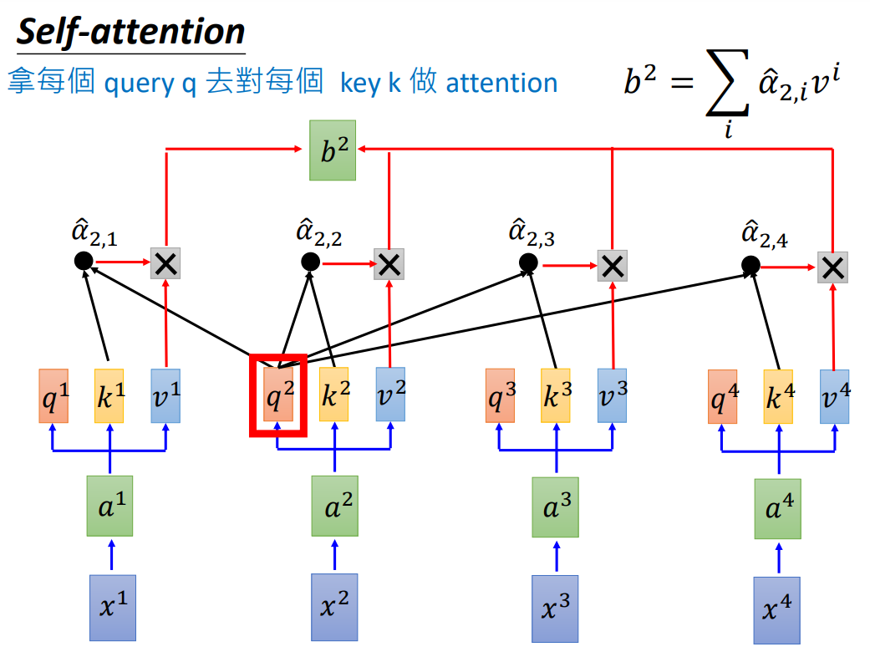

Slide 17
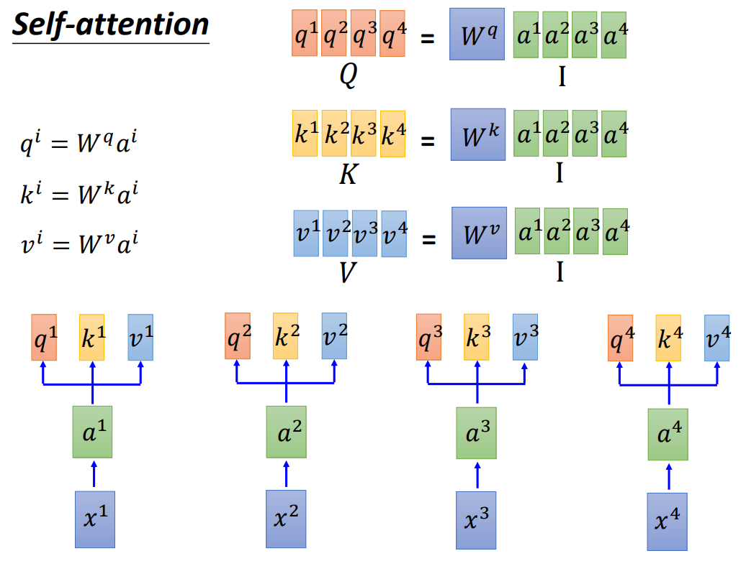

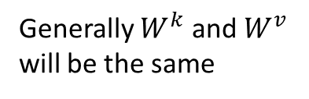
Generally $W^{k}$ and $W^{v}$ will be the same
Notes:
X1, x2, x3, and x4 are the word embeddings from CBOW or skip-gram.
Then, we pass the word embeddings to the linear layer (fully connected feed-forward network) to get a1 to a4.
The a1to a4 will concatenate together, and multiply with Wq, Wk, and Wv respectively.
Wq, Wk, and Wv are parameters you need to train.
Usually, Wk, and Wv will be the same.
Finally we have Q, K , V matrix here.

Slide 18
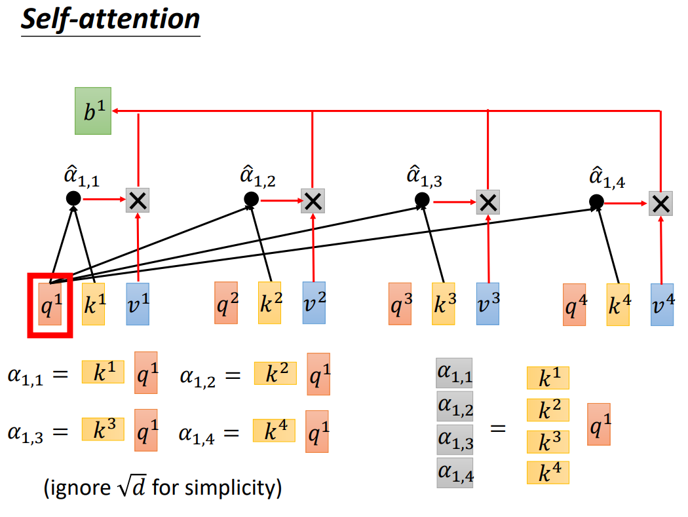
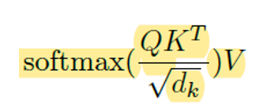
Notes:
After calculating Q, K , V matrices, we will do the inner product between Q and K.
So, q1 will multiply with k1, k2, k3, k4 to get the$α$11, $α$12, $α$13, $α$14.
you can calculate together like this one.

Slide 19
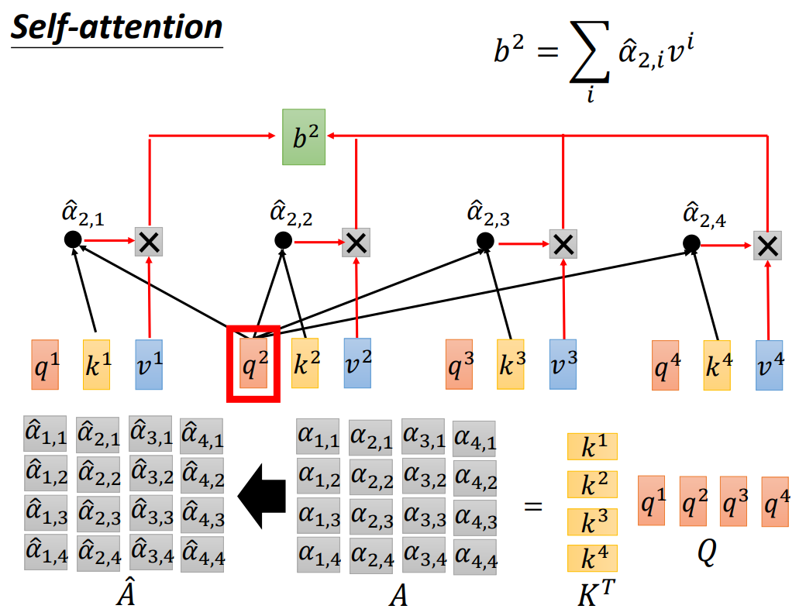
Notes:
And do the same thing to the q2
multiply with k1, k2, k3, k4 to get the$α2$1, $α22$, $α2$3, $α2$4.
And then, do the same thing to the q3, q4…, and so on.
we can simplify the calculation like this one. Just transpose the K, and multiply with Q.
After that, we have this part. So we need to dive by the square of dimension k.
In our code, the dimension k is 512, and do the softmax to for each column to get the A head.
And we called the A head “Attention matrix”.

Slide 20
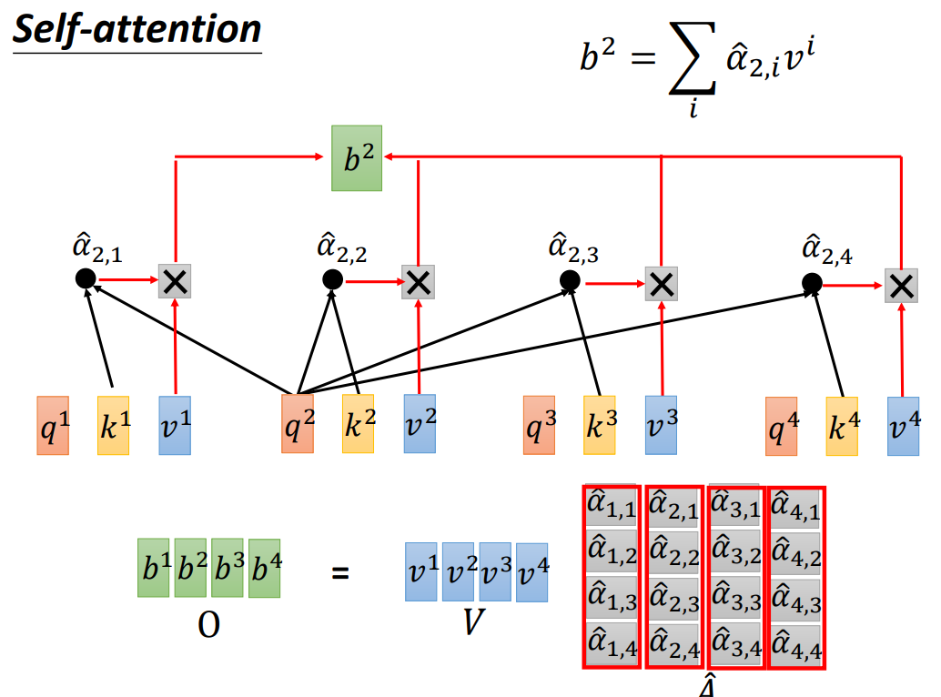
Notes:
In the last step, the attention matrix just multiplies with V.

Slide 21
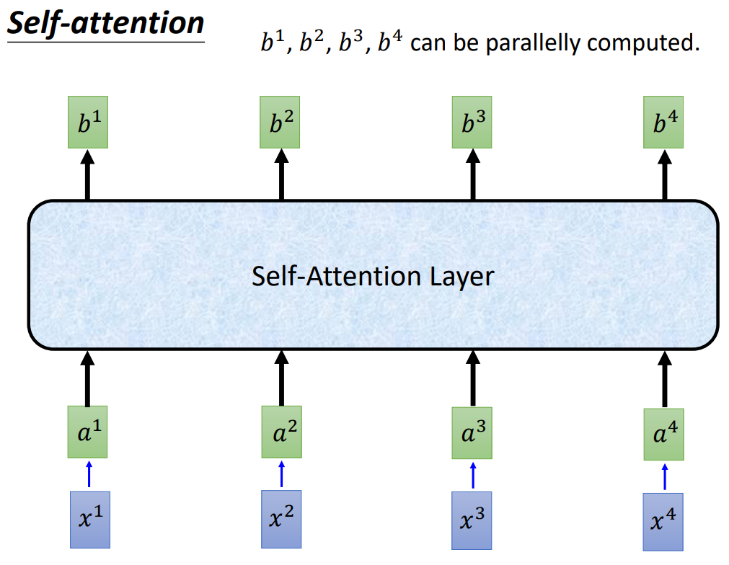
Notes:
So all of the self-attention layer does is matrix multiplication.
It’s easy to parallelize.

Slide 22
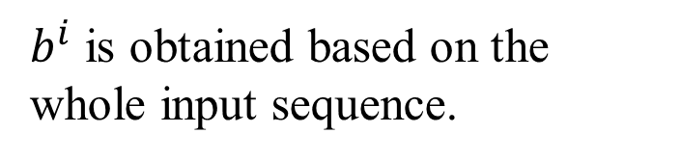
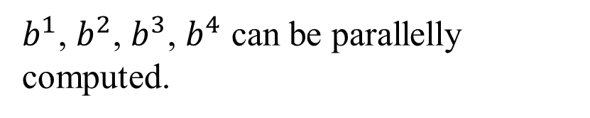









Self-Attention
Self-Attention Layer
You can try to replace any thing that has been done by RNN with self-attention.
Notes:
Nowadays, we can try to replace any thing that has been done by RNN with self-attention

Slide 23
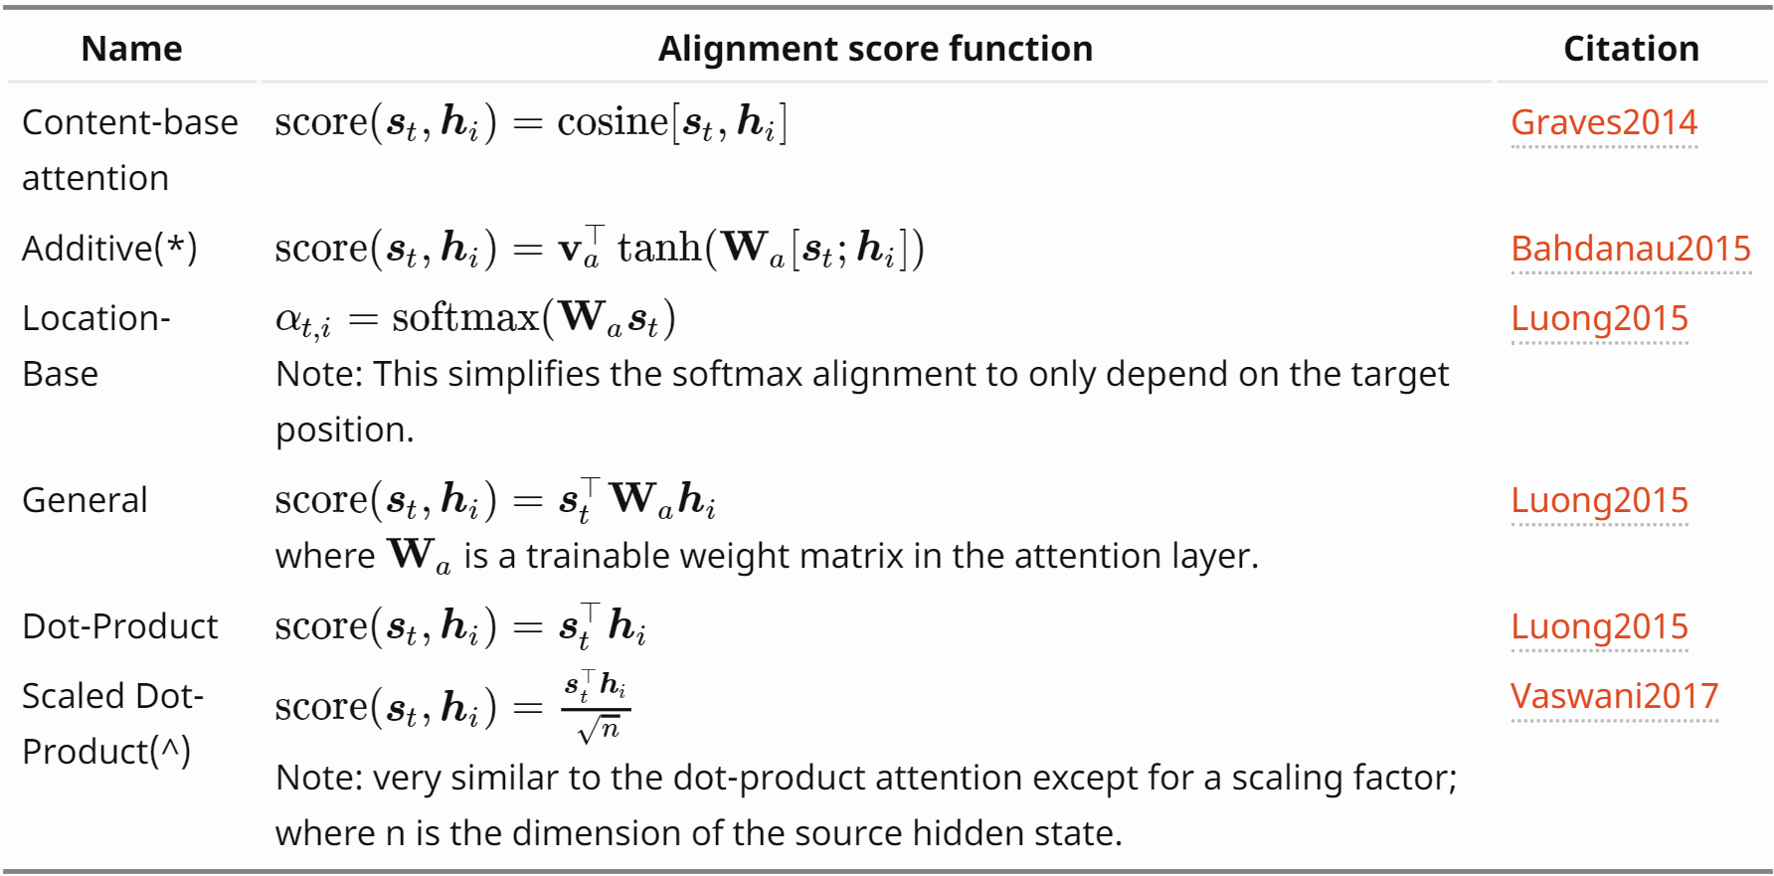

Alignment score function
Source: https://lilianweng.github.io/lil-log/2018/06/24/attention-attention.html#summary
Notes:
Notice that not only Scaled Dot-Product Attention, there are lots of attention skills.

Slide 24
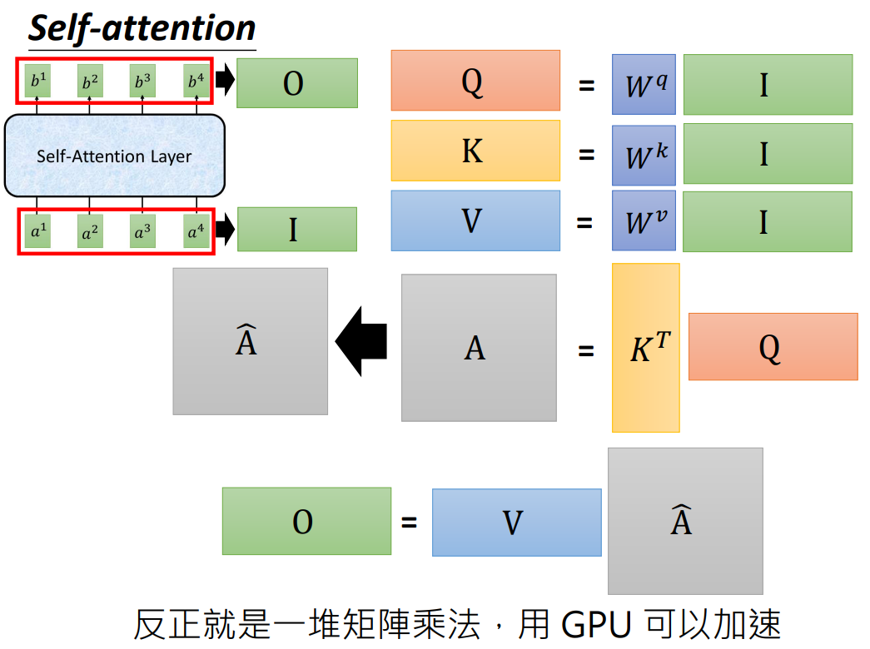

Slide 25
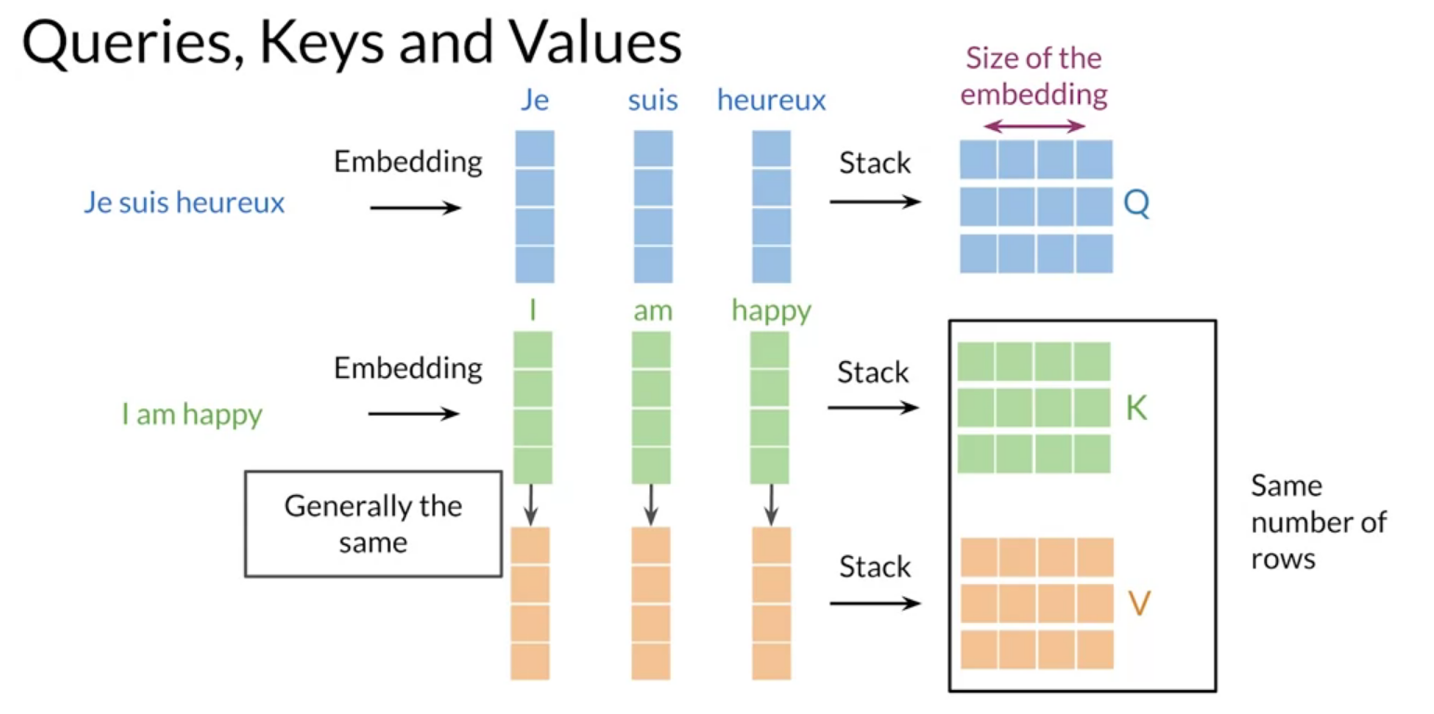

Slide 26
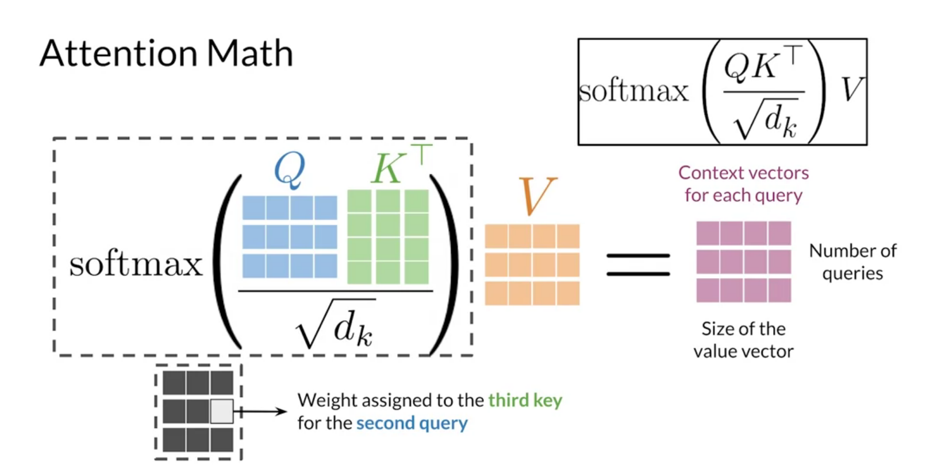

Slide 27
Transformers
Notes:
Next part is how to do the mask.

Slide 28
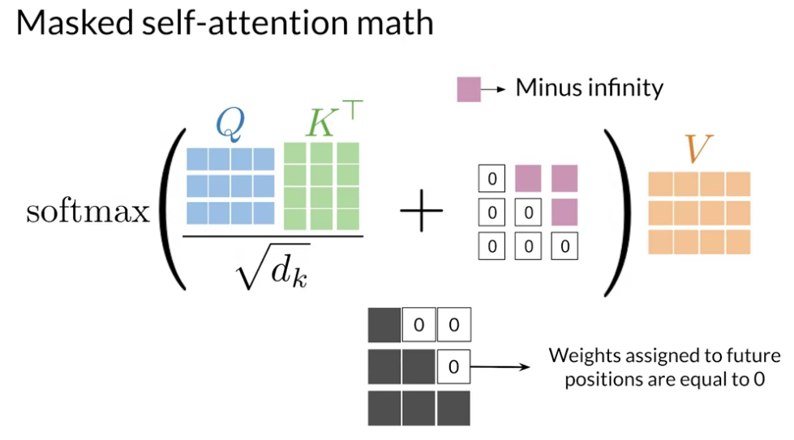
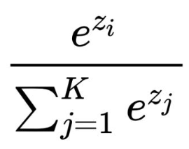
Notes:
The way to mask is that add the minus infinity into the attention matrix before softmax.
So, when minus infinity goes through the softmax, the output will be zero.

Slide 29
Positional encoding
(Using sine and cosine functions to generate positional embedding)
Notes:
The next part is Positional encoding.
I think it’s the most difficult part in transformer.

Slide 30
Transformers
Notes:
Positional encoding. It adds positional information into the word embedding.

Slide 31
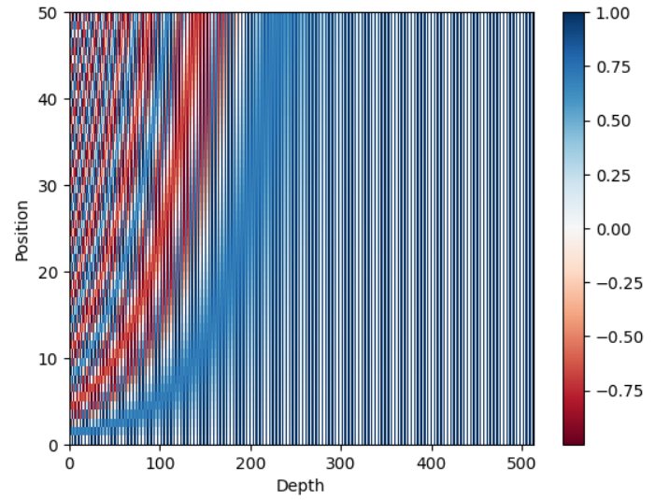
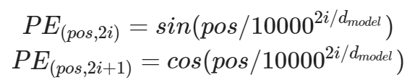
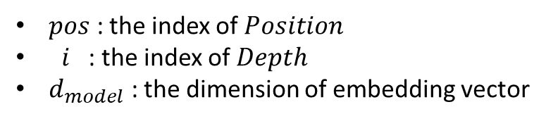
Positional encoding
$pos$ : the index of $Position$
$i$ : the index of $Depth$
$d_{model}$ : the dimension of embedding vector
Notes:
This is the formula of positional encoding.
It’s hard to understand the formula, so we draw the picture here.
Pos is the index of position.
$i$ is the index of $Depth$
When the I depth enough, the odd will be 1, even will be zero.

Slide 32
Transformers
Notes:
The next part is multi-head attention.
The idea of using multi-head attention is pretty easy.
It is just used to consider different situations. Or you can say extract different information to the model

Slide 33
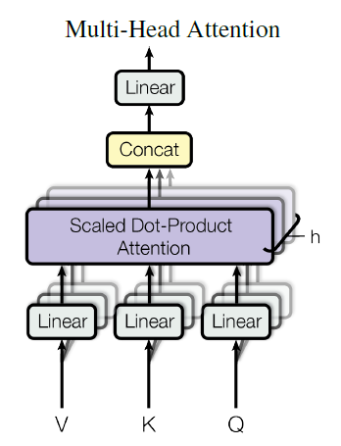

Multi-Head
Notes:
Here is the formula of multi-head attention.
They do many times scaled dot-product attention, and concatenate them.
And then, pass them into the linear layer.
The only thing you need to care about is the dimension.
It’s hard to explain, but I think you can figure it out during coding.

Slide 34
Transformers
Notes:
The last part is layer normalization.

Slide 35
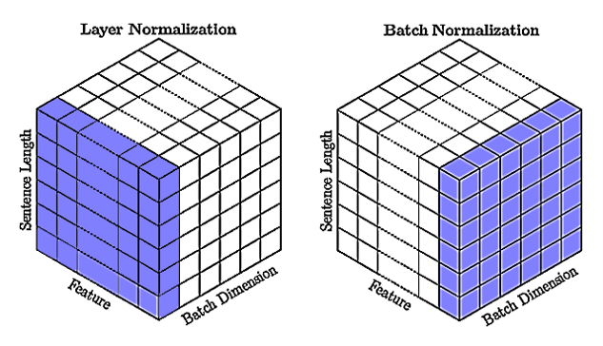

Layer Normalization
Formula:
Notes:
This is the formula of Layer Normalization.
Input minus means, and then divide by the root of variance.
Notice that the calculation didn’t coss the batch.

Slide 36
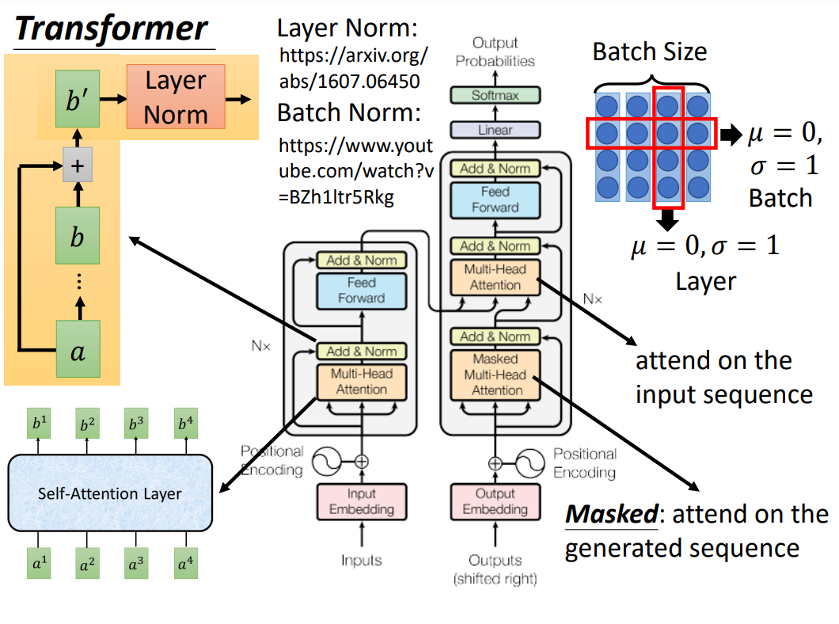

Slide 37
Why Self-Attention
One key factor affecting the ability to learn such dependencies is the length of the paths forward and backward signals have to traverse in the network. The shorter these paths between any combination of positions in the input and output sequences, the easier it is to learn long-range dependencies [11].
Notes:
Here is another reason why we need Self-Attention.
You can look at by yourself.

Slide 38
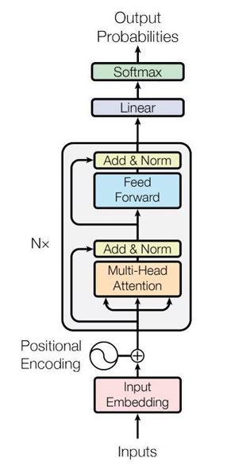
Transformer (Encoder)
Feed Forward
Layer normalization
Scaled dot-product attention
Sine / Cosine
Skip-gram / CBOW
Notes:
Finally, we have homework.
In today’s homework, you will implement NER Using Transformer Encoder.
We use the CoNLL2003 dataset.
The input will be a sentence, and we will use Skip-gram or CBOW to calculate word embedding.
The positional encoding is already finished. You can see the calculation process.
Then, you need to make Scaled dot-product attention, Multi-Head attention, and hole Encoder.
After that, you can run the training and evaluating to see the score.

Slide 39



Homework
English version
Chinese version
Post test
URL: https://drive.google.com/drive/folders/1CGTbW8I6O2mlnZIHU0MhER-1_9-7tLE6?usp=sharing
Notes:
There are English versions and Chinese versions.
You can choose anyone you like.
After you finish coding, we will check your code.
If there is nothing wrong, the TA will ask some questions from “Post test” document to make sure you understand today’s lecture.
I put lots of hints in the collab, so I think you can do it without my explanation.
But if you have some questions during coding, please let me know

